Slide 1
PAROVARIAN CYST
Dr Shanthi Serene Sylum V
Professor and Head
Dept. Obstetrics and Gynaecology
SKHMC Kulasekharam

Slide 2
INTRODUCTION
Parovarian cyst may arise either from the vestigial remnants of wolffian in the mesosalphinx or from the peritoneal inclusion or from the tubal epithelium.
The ovary is separated and the uterine tubes are stretched over the cyst. The cyst is unilocular; the wall is thin and contains clear fluid. The wall consists of connective tissue formed by single layer of cuboidal or flat epithelium. There may be a single layer of muscle tissue along with secretory epithelium suggesting tubal origin. It is always benign.

Slide 3
PATHOLOGY
They usually occur around the broad ligament and arise from paramesonephric, mesothelial, or mesonephric remnants. They are usually simple cysts. They are always benign in nature.

Slide 4
TERMINOLOGY
Paraovarian cysts are also sometimes referred to as paratubal cysts or hydatid cysts of Morgagni.

Slide 5
EPIDEMIOLOGY
They typically occur in women at the ages of 20-40 years old.

Slide 6
CLINICAL PRESENTATION
Most are asymptomatic, although patients with large lesions can present with pelvic pain.
Symptoms include
1.Bloating or pressure in your lower abdomen.
2.lower abdominal pain
3.nausea and vomiting if the cyst is twisting an ovary
4.frequent urination if the cyst is large enough to press on your bladder
5.sudden, severe pain if the cyst ruptures.

Slide 7
PELVIC ULTRASOUND
Typically thin-walled and smoothly marginatedmost often appear as unilocular 'simple' cysts (in ~66%) and rarely as multilocular (~4%)a soft tissue nodule in the cyst may indicate the development of a neoplasm (rare)9%.

Slide 9
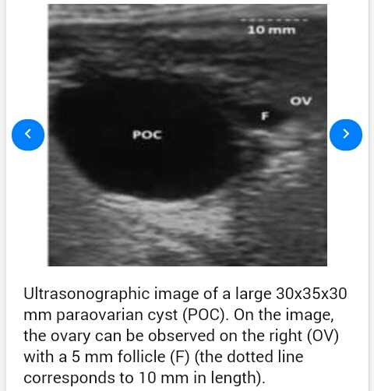

Slide 10
PELVIC MRI
Often seen located close to the ipsilateral round ligament and are often of homogenous signal intensity.
In uncomplicated cases, signal characteristics usually follow that of fluid.
Can be hyperintense if complicated by hemorrhage.

Slide 11
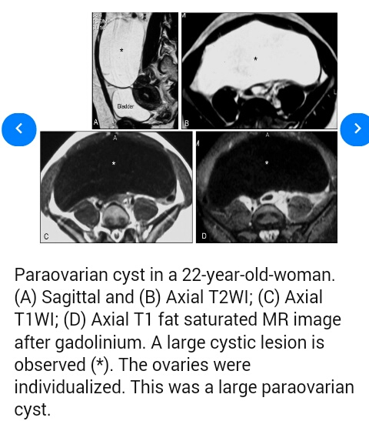

Slide 12
COMPLICATIONS
Paraovarian cysts occasionally can be complicated by rupture, torsion, or hemorrhage.

Slide 13
DIFFERENTIAL DIAGNOSIS
For an adnexal cystic lesion consider:
1.True ovarian cystovarian cystic neoplasm: typically has a solid component.
2.Paraovarian cystadenoma: typically has a small solid nodule or
3.Septum pelvic peritoneal inclusion cyst.

Slide 14
MANAGEMENT
Smaller asymptomatic ones are treated conservatively. For simple paraovarian cysts with no suspicious features on ultrasound, follow-up recommendations are the same as for ovarian cysts.
Large or symptomatic cysts often undergo surgical resection is recommended.

Slide 15
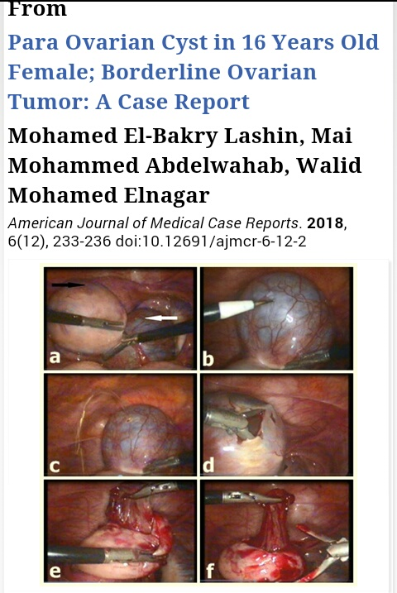

Slide 16
According to a consensus statement by the Society of Radiologists in Ultrasound follow-up is recommended for cysts that are:5-7 cm in a woman of reproductive age and 1-7 cm in a postmenopausal woman. Irrespective of age, cysts larger than 7 cm warrant further evaluation (with MRI) or surgical review.

Slide 17
HOMEOPATHIC THERAPEUTICS
1.BOVISTA LYCOPERDON
Diarrhea before and during menses. Menses too early and profuse ;worse at night. Voluptuous sensation. Leucorrhoea acrid; thick ; tough; greenish following menses. Cannot bear tight clothing around waist. Traces of menses between menstruation. Soreness of pubes during menses. Metrorrhagia; Parovarian cyst.

Slide 18
2.COLOCYNTHIS
Boring pain in the ovary. Must draw up double with great restlessness. Round ;small cystic tumors in ovaries or broad ligament. Wants abdomen supported by pressure. Bearing down cramps; causing her to bend double.

Slide 19
BIBLIOGRAPHY
1.D.C. DUTTA's Textbook of Gynecology.
2. Pocket manual of Homeopathic Materia Medica & Repertory by Dr. William Boericke. MD
3.https://radiopaedia.org/articles/paraovarian-cyst.
4.https://www.healthline.com/health/womens-health/complex-ovarian-cyst.
5.https://sites.google.com/site/casesonography/pelvis/para-ovarian-cyst.

Slide 20
THANK YOU

